Slide 1
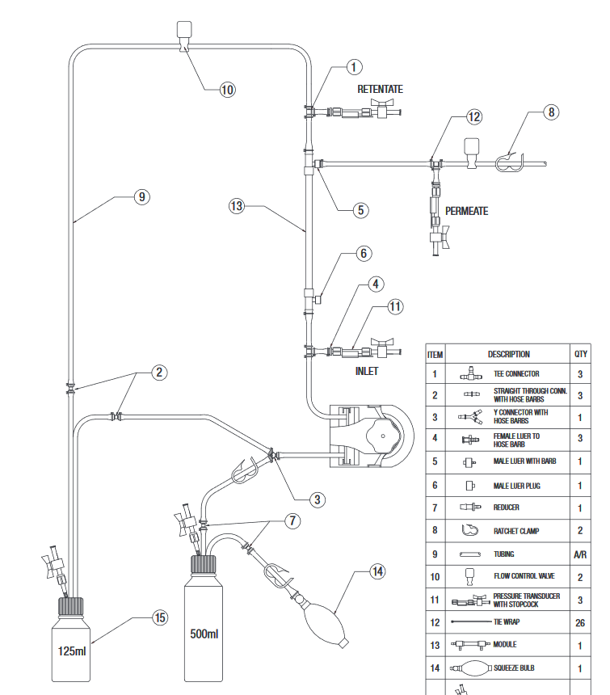

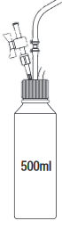
backpressure valve
retentate
pressure transducer
manual clamp
permeate
reservoir
permeate
valve
membrane module
permeate
pressure transducer
feed
pressure transducer
manual
clamp
pump
feed
valve
buffer
valve
buffer
reservoir
feed
reservoir

